Slide 1
UWSP 2
John Rusch, Lucas Paul, Derek Piotrowski

Slide 2
Overview
Our Clients
Village Gardens
Ciclovia
Alumni Association
Code Features
Demos
What’s Next?
Questions

Slide 3

Village Gardens Introduction
Client’s Needs
Picking Up The Project
Promote Their Store
Name Change From Lensmire's
Search Engine Optimization
Easy Editability
Social Media Connections

Slide 4
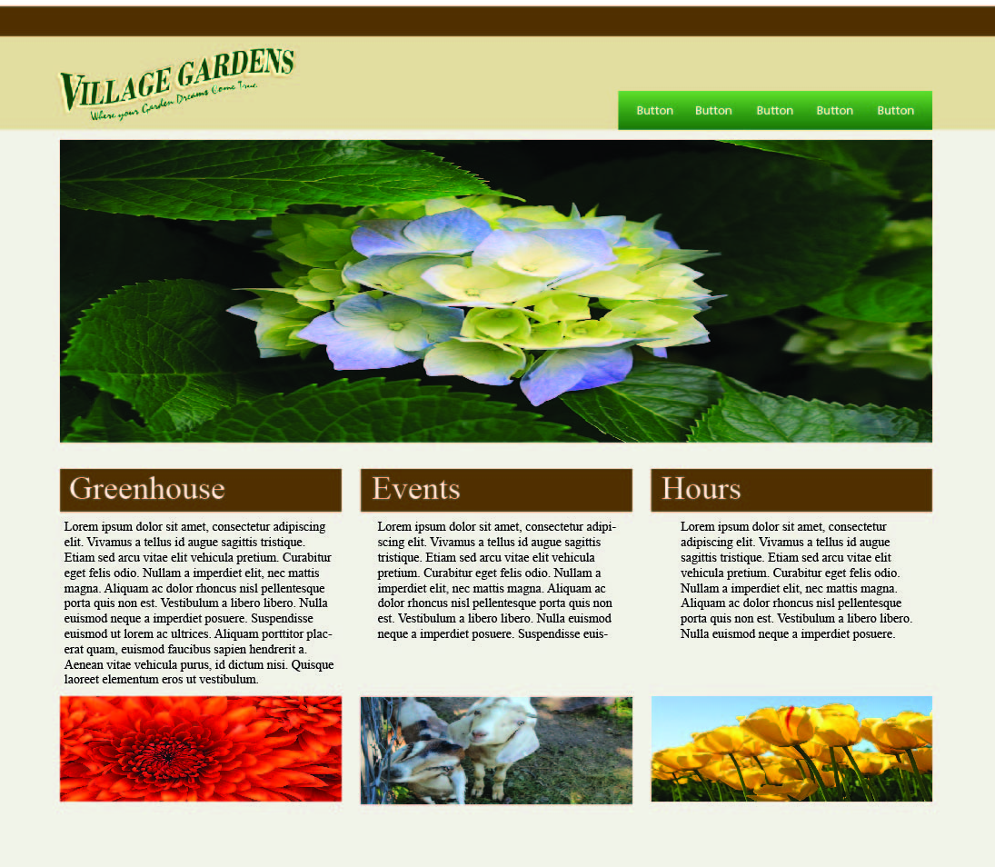
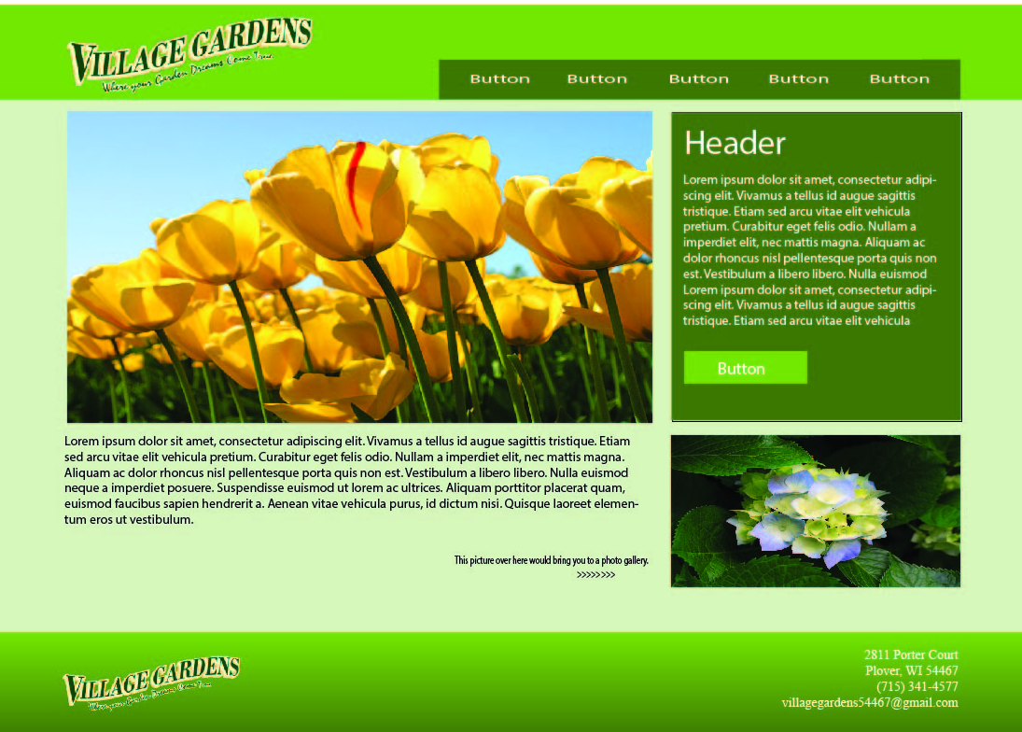
Village Gardens Design
Inspired By
Natural Color Scheme
Color Scheme Built From Logo
First Versions

Slide 5
Village Gardens Design
Final Designs
Constructed From Their Favorite Parts Of Initial Designs
Prominently Features Contact Information And Social Media
Large Images That Show The Greenhouse
Pages And Slides That Describe What They Do
Better Representation Of Village Gardens

Slide 6
Village Gardens Demo
Responsive Template Demo

Slide 7
Village Gardens Recap
Achievements
Responsive Template Built
Wordpress Development Environment (Godaddy)
Roadblocks
Responsive Template Styling/Layout Hurdles
Future Steps
Converting Templates To Wordpress
Creating Templates For Interior Pages
Implement Working Slideshow
Fill With Content

Slide 8
Village Gardens Feedback
Questions?
Feedback?

Slide 9

Ciclovia Introduction
Local Annual Health Promotion Event
Client’s Needs
Independent Of UWSP
Promote The Event
Flexible Website That Can Grow With The Event
Design Is Appropriate For Audience

Slide 10
Ciclovia Needs
Functions Of The Website
Give Updates On The Event
Display Event Route
Image Gallery Of Past Events
Contact Information
List Of Sponsors And Vendors

Slide 11
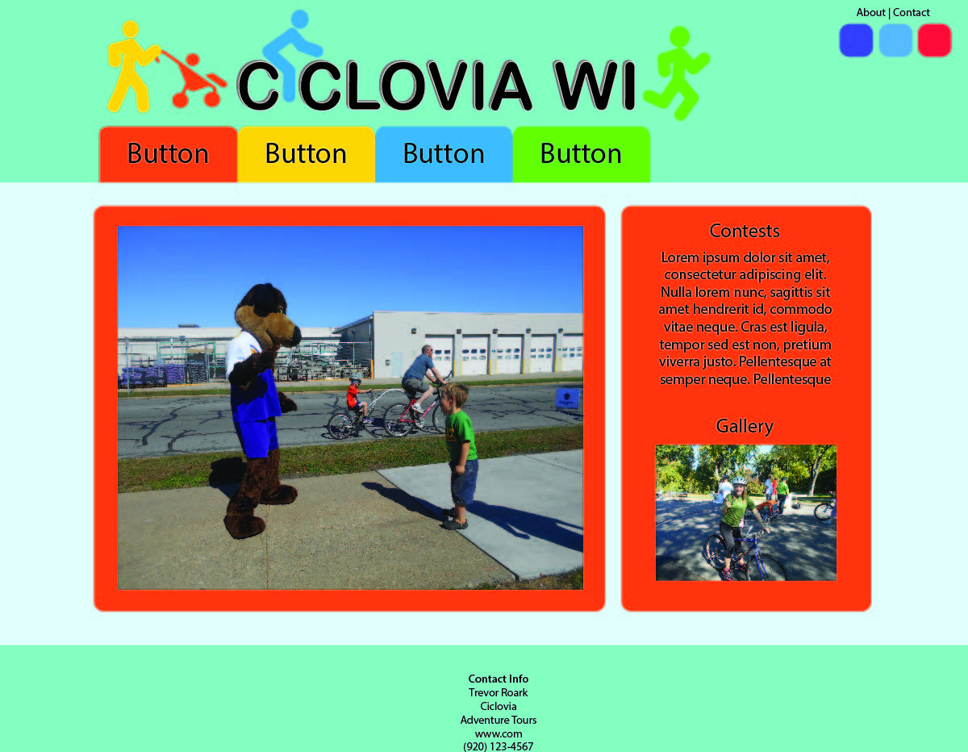
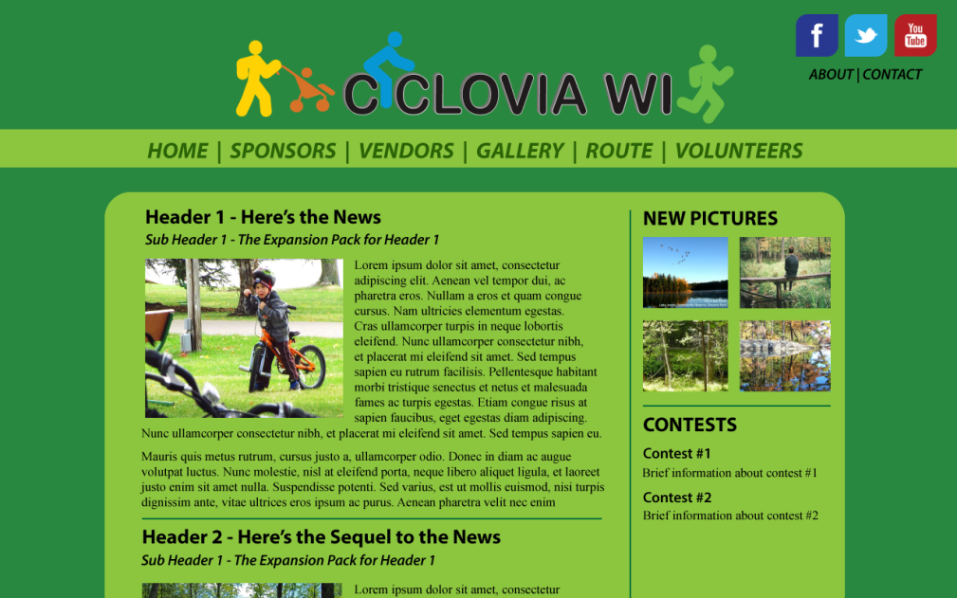
Ciclovia Design
Influences
Active Portage County
Intended To Be Family Friendly
First Versions

Slide 12
Ciclovia Design
Final Design
Utilizes Large Image Areas
Green Color Matches “Outdoors” Feel
Rounded Corners More Friendly

Slide 13
Ciclovia Demo
Responsive Template Demo

Slide 14
Ciclovia Recap
Achievements
Responsive Template Built
Wordpress Development Environment (Godaddy)
Roadblocks
Local Wordpress Environment
Responsive Template Styling/Layout
Future Steps
Converting Templates To Wordpress
Creating Templates For Interior Pages

Slide 15
Ciclovia Feedback
Questions?
Feedback?

Slide 16

Alumni Association Introduction
Client’s Needs
Campus Tour App
Homecoming
120th Anniversary
Campus Research
Information About Tour Destinations
UWSP Design Standards
PhoneGap Framework
Cross Platform
GPS Integration

Slide 17

Alumni Association Demo
Landing Screen
Campus Map
Location

Slide 18

Alumni Association Demo
Launches GPS Code
Finds Your Coordinates
Checks Parameters

Slide 19
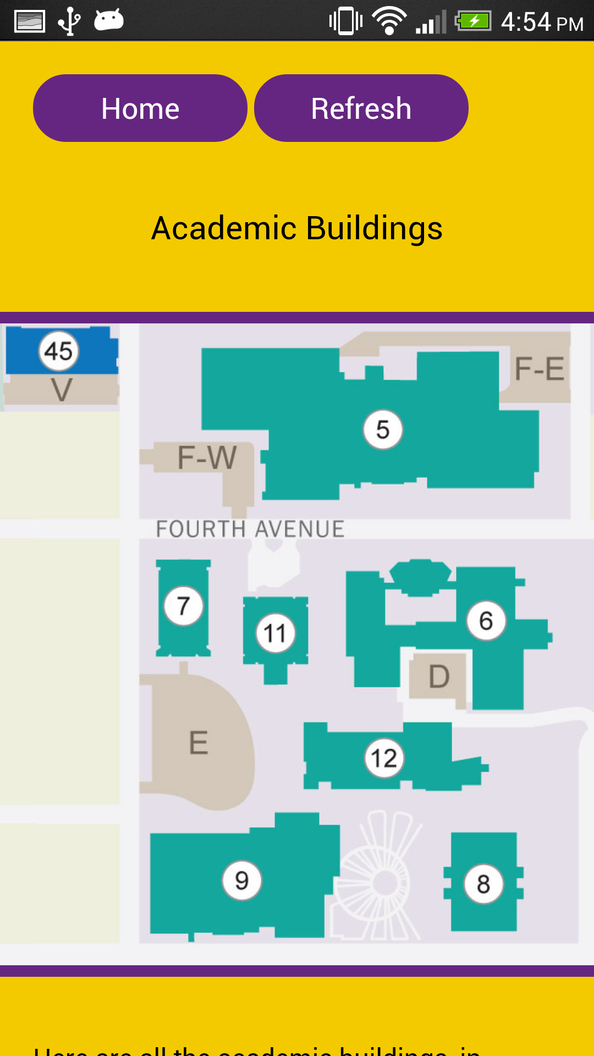
Alumni Association Demo
Brings You To Location Selector
Shows You The Nearby Buildings
Displays Relevant Message

Slide 20
Alumni Association Demo
Blurbs
Mural
The mural that covers a large portion of the south wall of the science building was started in 1975, when Chancellor Lee S. Dreyfus approached Art Professor Richard C. Schneider to cover the empty wall. The mural features prominent images of a human figure, the Old Main Cupola, and a map of the Portage County area. The mural also features important Wisconsin imagery such as a white-tailed deer, a Muskie, robins, violets, native leader Black Hawk, and a maple leaf. The design is made of 286,200 2-inch square tiles, each with a design representing disciplines in the natural resources department. One campus legend says that there is a single red colored tile somewhere in the mural, and challenges students and visitors alike to find it.

Slide 21
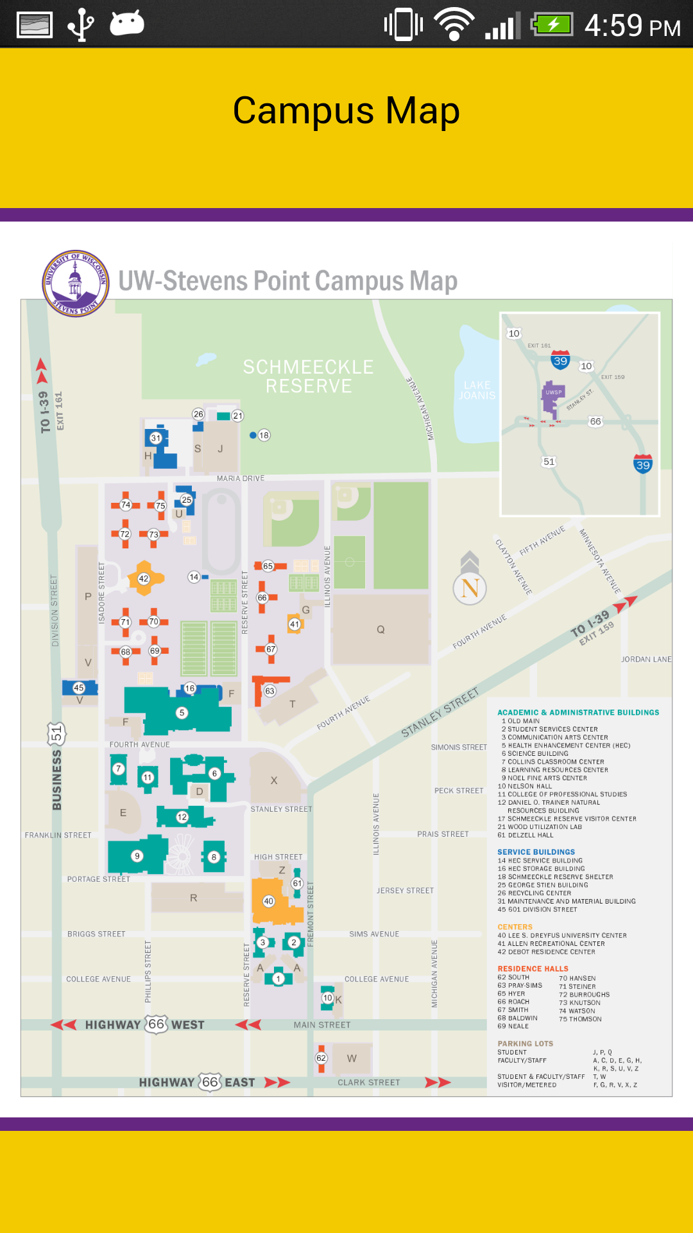
Alumni Association Demo
Scrollable/Zoom-able Map

Slide 22
Alumni Association Recap
Achievements
Project Framework Built
GPS Working
Future Steps
Refine Navigation/GPS Role
Build for iOS
Manage Data Feed
Design For Multiple Devices

Slide 23
Alumni Association Feedback
Questions?
Feedback?

Slide 24
What’s Next
Build PHP Templates For Wordpress
Flesh-Out Website Interiors
Have App Content Approved By UWSP
Build Data Feed For App

Slide 25
Questions?

